Slide 1

Data Analytics Project
Credit Card Fraud Detection
Name: Chi Phi
LinkedIn: www.linkedin.com/in/chi-phi
Email address: chi.phithikim@outlook.com.vn
Phone number: 07724087363

Slide 2
Table of Contents
01
02
Introduction
Dataset
03
04
Analysis & Results
Conclusions

Slide 3

Introduction
01

Slide 4

Nowadays, Cybercriminals profit from the ongoing advancements in technology. Every year in the United Kingdom, millions of pounds are lost due to card fraud. Criminals different ways to get cardholder's details.
→ It is important that credit card companies are able to recognize fraudulent credit card transactions so that customers are not charged for items that they did not purchase.

Slide 5

Dataset
02

Slide 6
This dataset presents transactions that occurred in 2 days (172,792 seconds), where we have 492 frauds out of 284,807 transactions.
The dataset contains transactions made by credit cards in September 2013 by European cardholders.
The dataset is highly unbalanced, the positive class (frauds) account for 0.172% of all transactions.

Slide 7

Features
Features V1, V2, … V28 are the principal components obtained with PCA
Feature 'Time' contains the seconds elapsed between each transaction and the first transaction in the dataset.
The feature 'Amount' is the transaction Amount, this feature can be used for example-dependent cost-sensitive learning.
Feature 'Class' is the response variable and it takes value 1 in case of fraud and 0 otherwise.

Slide 8

Analysis & Results
03

Slide 9

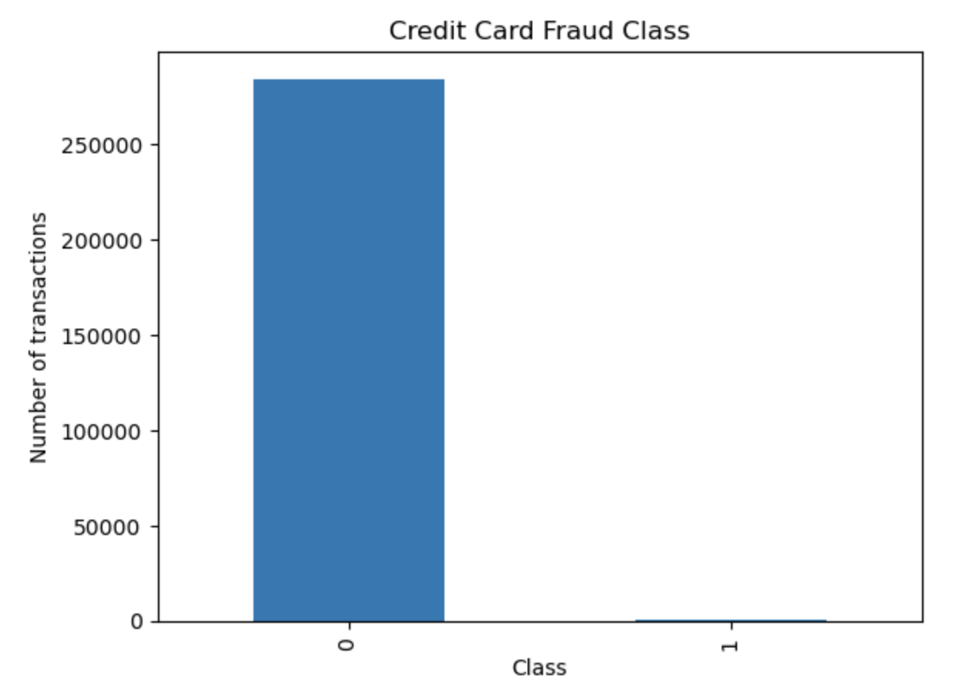
There are only 492 (or 0.172%) of transaction that are fraudulent.
→ It means the data is highly unbalanced with respect with target variable Class.

Slide 10

Fraudulent transaction
Non-fraudulent transactions
Count | 492.000000
Mean | 122.211321
Std | 256.683288
Min | 0.000000
25% | 1.000000
50% | 9.250000
75% | 105.890000
Max | 2125.870000
Count | 284315.000000
Mean | 88.291022
Std | 250.105092
Min | 0.000000
25% | 5.650000
50% | 22.000000
75% | 77.050000
Max | 25691.160000

Slide 11
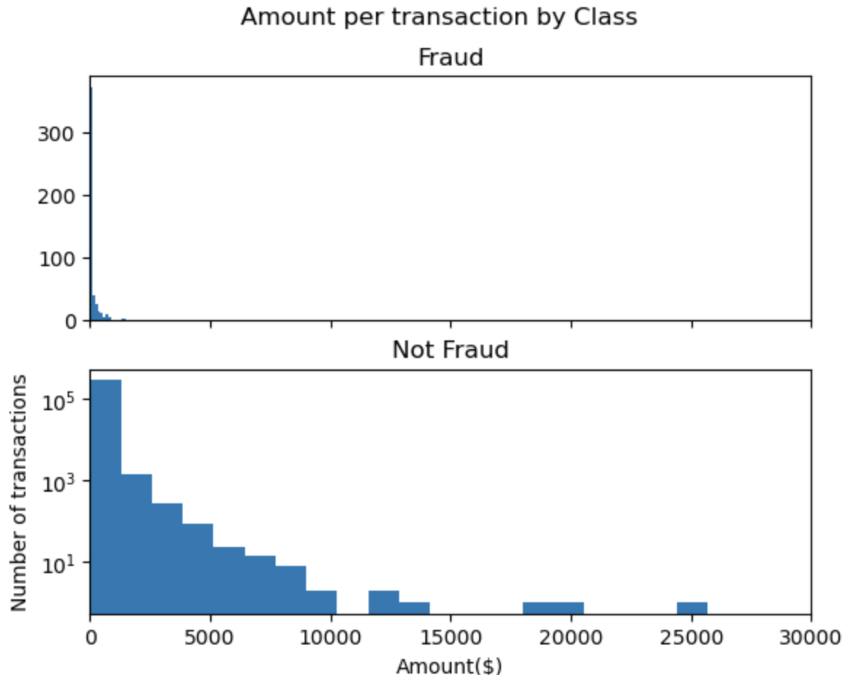
Fraud transactions make up a very small share with extremely modest quantities
Whereas, not fraud transactions have a large number of transactions with values up to more than $25,000.

Slide 12


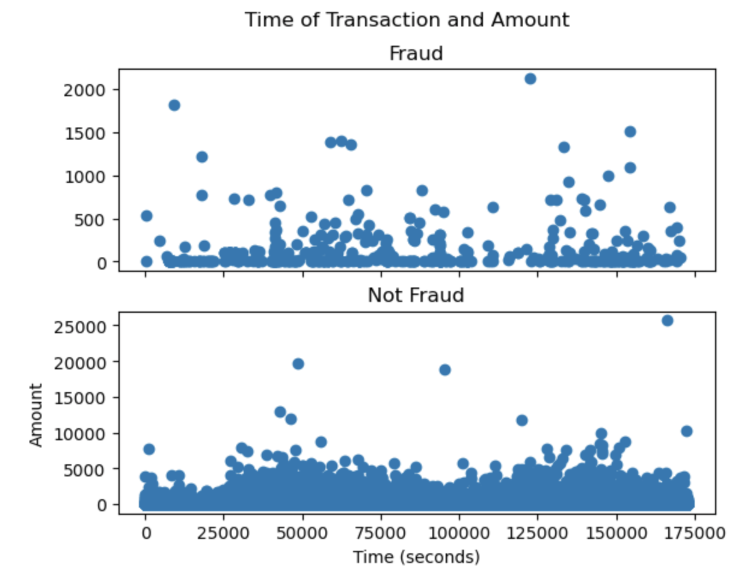
In terms of time, the figure illustrates that there are many different fraudulent and non-fraudulent transactions

Slide 13
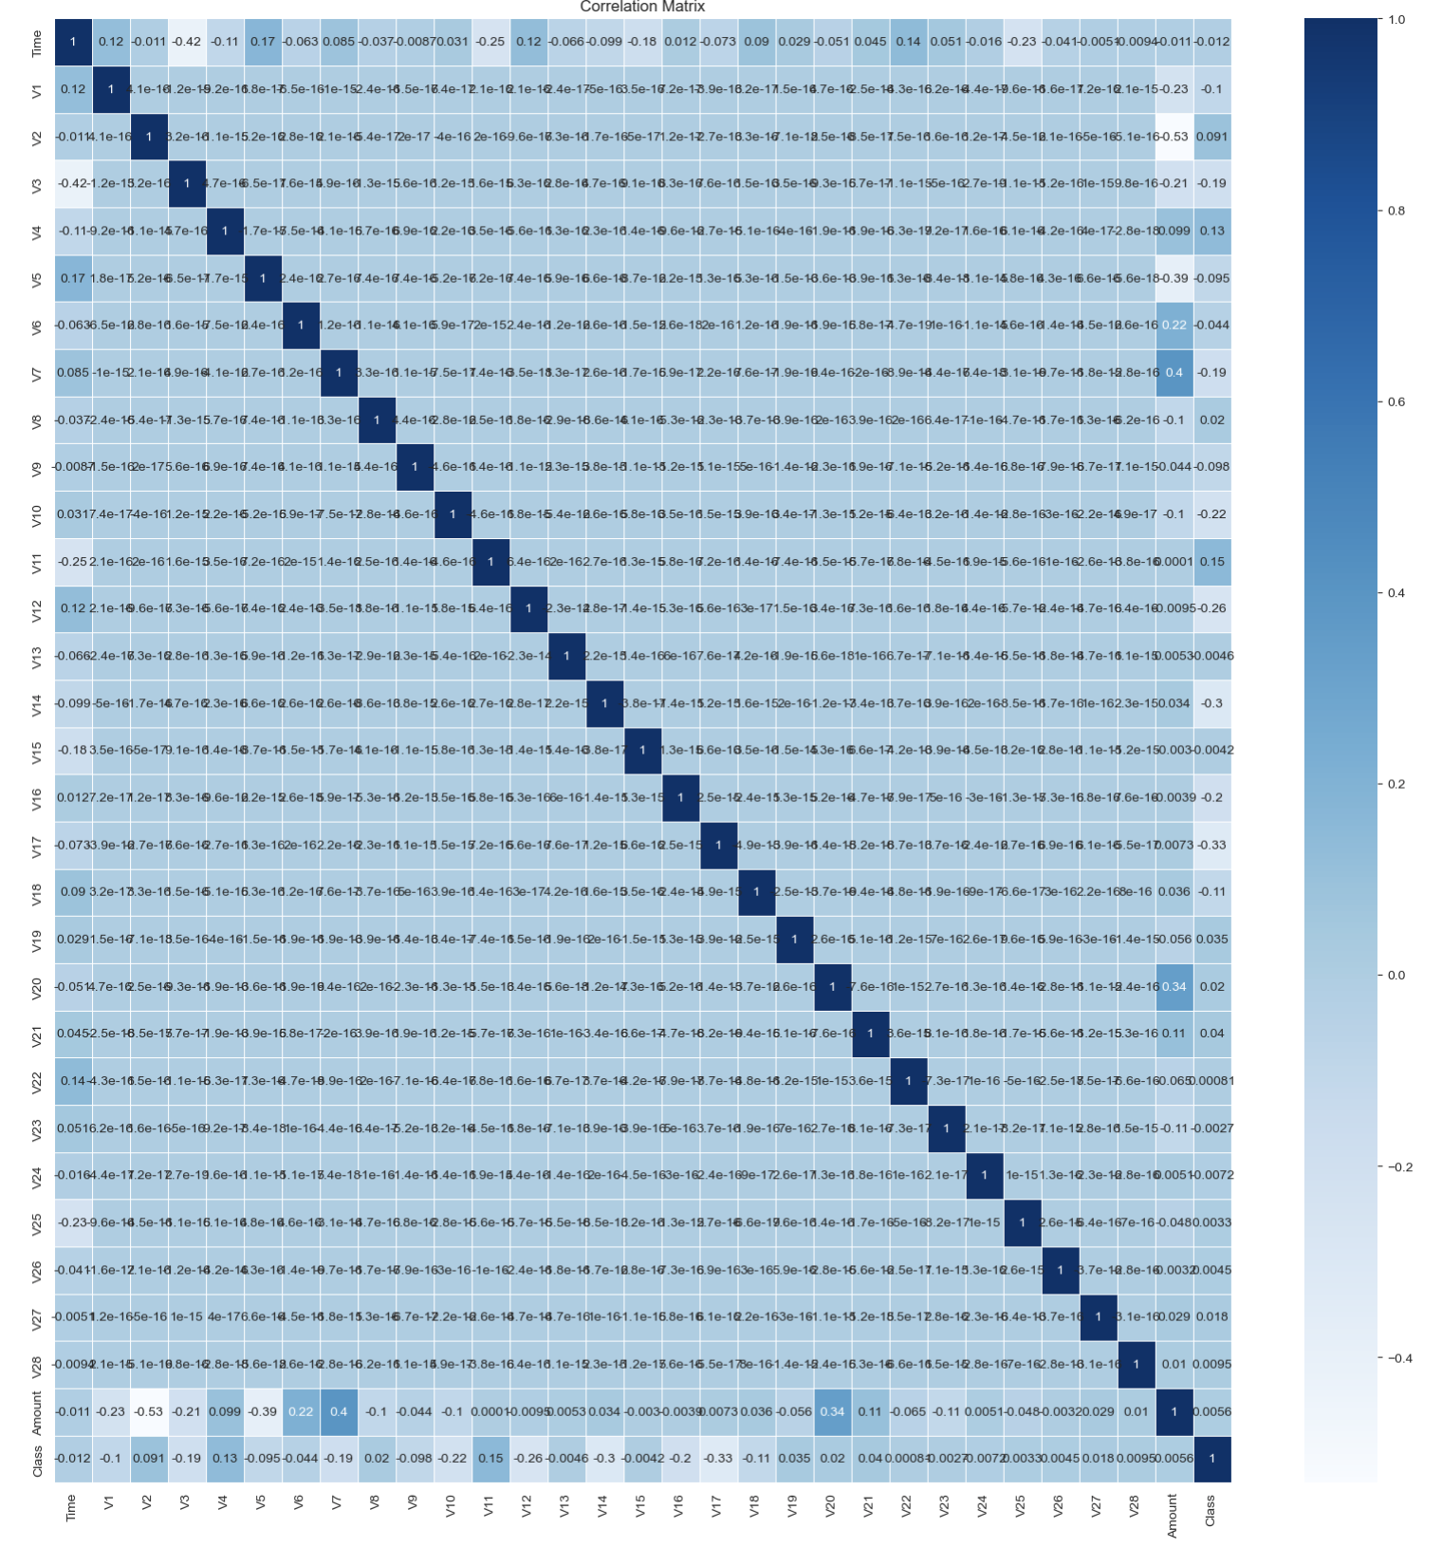
There is no notable correlation between features V1-V28.

Slide 14
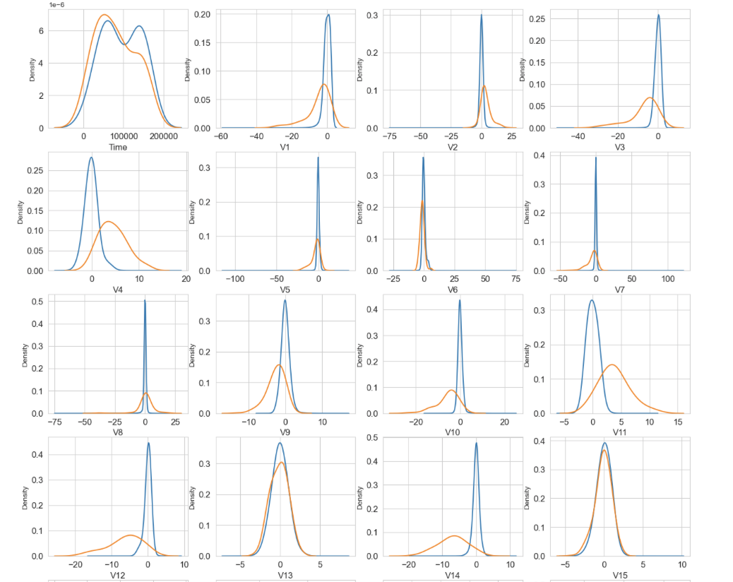
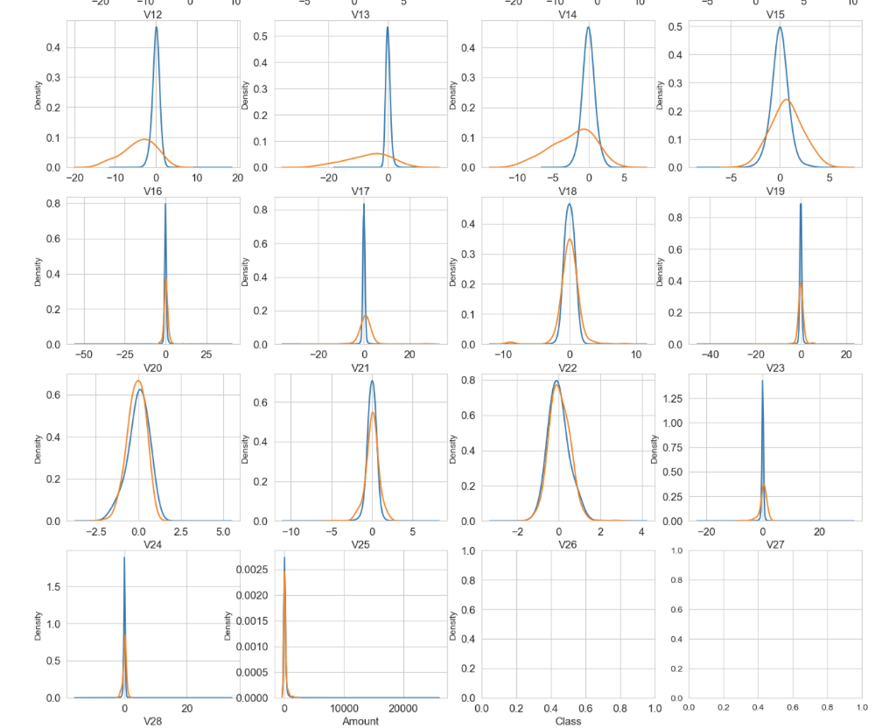

Slide 15

Features Density Plot
In terms of distribution for the two values of Class:
V4, V11 have clearly separated distributions
V12, V14, V18 are partially separated distributions
V1, V2, V3, V10 have a quite distinct profile
V25, V26, V28 have similar profiles.
For Time and Amount features:
The features distribution for non- fraudulent transactions (values of Class = 0) is centred around 0.
The fraudulent transactions (values of Class = 1) have a skewed (asymmetric) distribution.

Slide 16

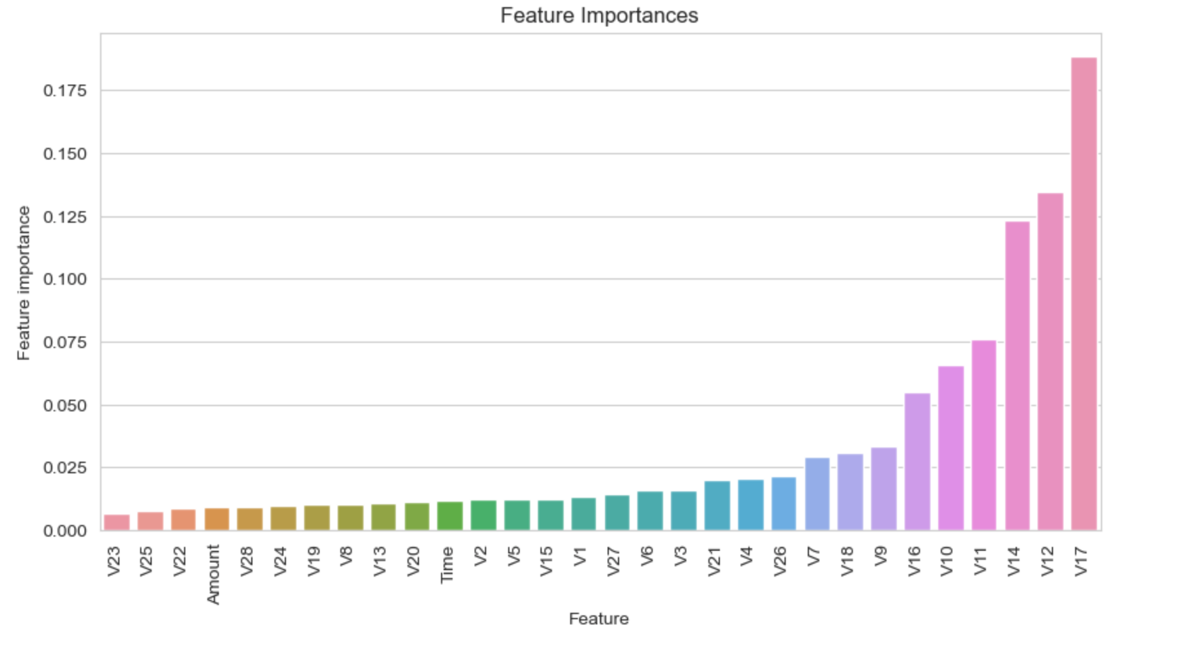
The most important features are V17, V12, V14, V11, V10, V16.
→ These features have large effect on the model

Slide 17

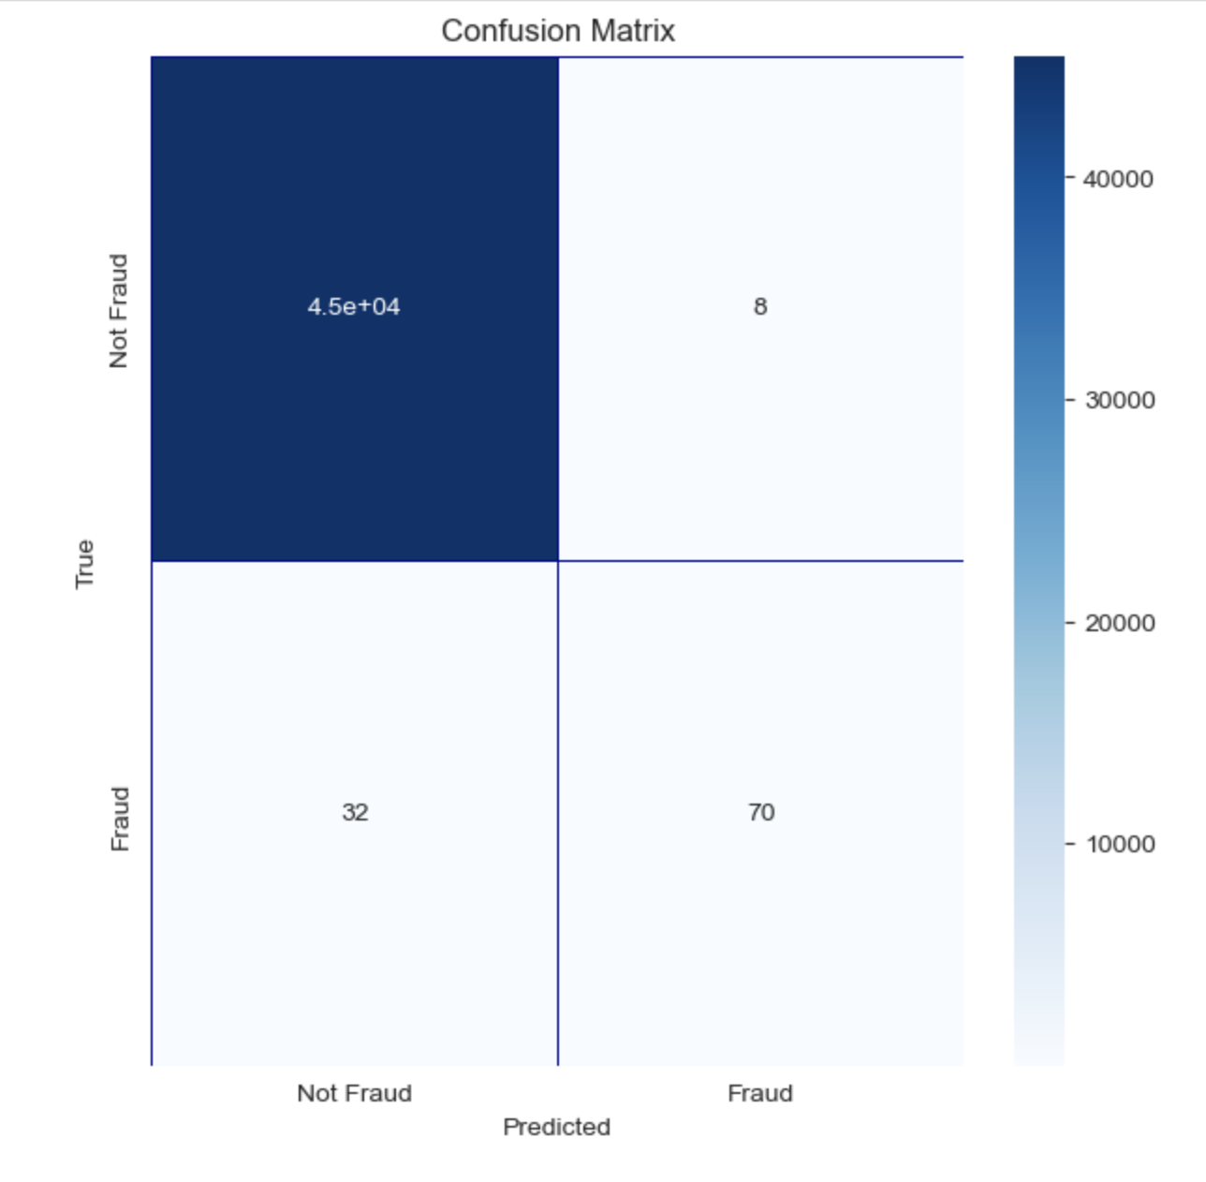
Confusion matrix accuracy is not meaningful for unbalanced classification, therefore, ROC-AUC score is calculated.
The ROC-AUC score obtained with RandomForrestClassifier is 0.843049279007356

Slide 18

Conclusions
04

Slide 19

This project investigated the data, checking for data unbalancing, visualising the features and understanding the relationship between different features. The data was split into 2 parts which are a training set and a testing set.
The ROC-AUC score for RandomForrestClassifier is 0.84, which is generally considered good.

Slide 20

Thank you!
Does anyone have any questions?
chi.phithikim@outlook.com.vn
07724087363

